Slide 1
Sviluppare contenuti digitali. Integrare e rielaborare contenuti digitali.
PARTNER: Arrabal-AID
S E N I O R S O N L I N E S E C U R I T Y F O R C R E A T I V I T Y
With the support of the Erasmus+ programme of the European Union. This document and its contents reflects the views only of the authors, and the Commission cannot be held responsible for any use which may be made of the information contained therein.
Legal description – Creative Commons licensing: The materials published on the SOS project website are classified as Open Educational Resources' (OER) and can be freely (without permission of their creators): downloaded, used, reused, copied, adapted, and shared by users, with information about the source of their origin.

Slide 2
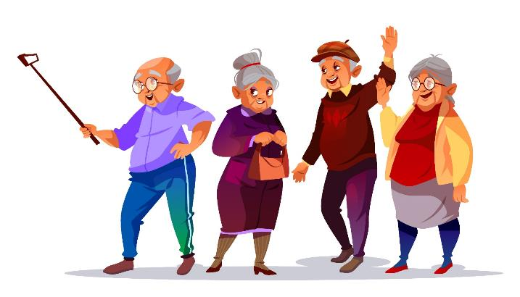
1. Obiettivi e finalità
Alla fine di questo modulo:
Conoscerai il programma gratuito OpenShot
Un programma gratuito di video editing che puoi installare sul tuo computer. Il programma ti permetterà di esportare video e immagini e creare nuove composizioni.
Imparerai l’arte del video editing (montaggio dei video)
Imparerai a unire i video, inserire le transizioni, aggiungere testi e musica, inserire immagini,
o a separare la parte audio dalla parte video .
Imparerai a usare le transizioni
Una volta che hai la musica, i testi, e la composizione, è ora di migliorare il ritmo del tuo video con l’impiego di transizioni animate e statiche.
With the support of the Erasmus+ programme of the European Union. This document and its contents reflects the views only of the authors, and the Commission cannot be held responsible for any use which may be made of the information contained therein.
Legal description – Creative Commons licensing: The materials published on the SOS project website are classified as Open Educational Resources' (OER) and can be freely (without permission of their creators): downloaded, used, reused, copied, adapted, and shared by users, with information about the source of their origin.

Slide 3
2. Unità 1: Le basi del video montaggio.
Il modulo ha l’obiettivo di insegnare al partecipante a padroneggiare gli strumenti per il montaggio di risorse audiovisive, così come i principi elementari per la produzione di video e l’utilizzo di effetti speciali nella creazione di media audiovisivi utilizzando risorse come: effetti, audio, musica e immagini libere.
Preparati a calcare il tappeto rosso dei prossimi premi audiovisivi, perché con questo corso padroneggerai gli strumenti del video montaggio.
With the support of the Erasmus+ programme of the European Union. This document and its contents reflects the views only of the authors, and the Commission cannot be held responsible for any use which may be made of the information contained therein.
Legal description – Creative Commons licensing: The materials published on the SOS project website are classified as Open Educational Resources' (OER) and can be freely (without permission of their creators): downloaded, used, reused, copied, adapted, and shared by users, with information about the source of their origin.

Slide 4
In sintesi
Finestra principale
Importare i file
Panoramica del tutorial incorporato, trace e livelli
Trascinare e rilasciare
Menù contestuale
Menù principale
Pulsante della barra degli strumenti
Scorciatoie da tastiera
Titoli
Transizioni
Modelli per i titoli
Titoli personalizzati
Modelli 3D animati
Tagliare
Modelli
Modificare la direzione delle transizioni
With the support of the Erasmus+ programme of the European Union. This document and its contents reflects the views only of the authors, and the Commission cannot be held responsible for any use which may be made of the information contained therein.
Legal description – Creative Commons licensing: The materials published on the SOS project website are classified as Open Educational Resources' (OER) and can be freely (without permission of their creators): downloaded, used, reused, copied, adapted, and shared by users, with information about the source of their origin.

Slide 5
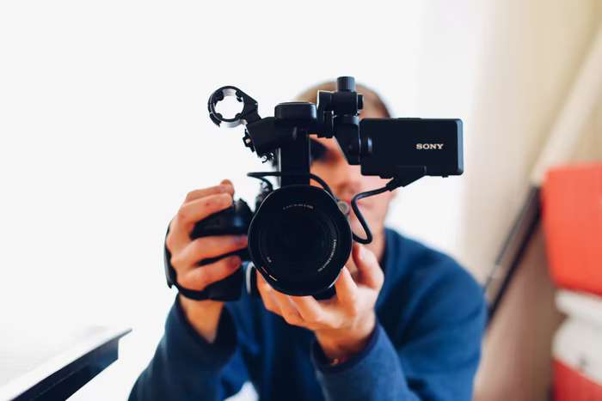
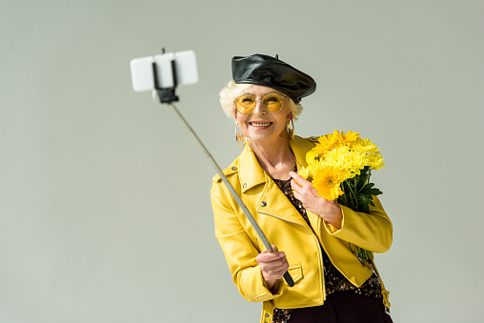
With the support of the Erasmus+ programme of the European Union. This document and its contents reflects the views only of the authors, and the Commission cannot be held responsible for any use which may be made of the information contained therein.
Legal description – Creative Commons licensing: The materials published on the SOS project website are classified as Open Educational Resources' (OER) and can be freely (without permission of their creators): downloaded, used, reused, copied, adapted, and shared by users, with information about the source of their origin.

Slide 6
Grazie!
PARTNER: Arrabal-AID
With the support of the Erasmus+ programme of the European Union. This document and its contents reflects the views only of the authors, and the Commission cannot be held responsible for any use which may be made of the information contained therein.
Legal description – Creative Commons licensing: The materials published on the SOS project website are classified as Open Educational Resources' (OER) and can be freely (without permission of their creators): downloaded, used, reused, copied, adapted, and shared by users, with information about the source of their origin.

